Slide 1
Kondo effect
Him Hoang
13.07.2011

Slide 2
Definition
Experimental Facts
Kondo‘s Calculation
Kondo Problem
Kondo Resonance in Quantum Dots
Kondo‘s Future

Slide 3
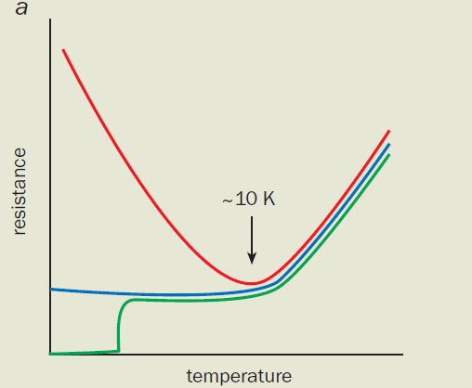
Definiton
an unusual scattering mechanism of conduction electrons in a metal due to magnetic impurities, which contributes to the electrical resistivity that increases logarithmically with temperature as the temperature is lowered
anomalous temperature dependence of physical quantities, which originates from many-body processes caused by quantum-mechanical nature of localized magnetic moments in a metal

Slide 4
the total spin of all the electrons in the impurity atom is non-zero
Anderson‘s model of a magnetic impurity (1961)
=> flip the spin of the impurity from spin up to down or vice versa, while simultaneously creating a spin excitation in the Fermi sea

Slide 5
Resistance Minimum
Difficulties in explaining the RM:
    the resistivity increasing with decreasing temperature
    the residual resistance is not a constant but varies even at helium temperature
    the universality of the phenomenon
Resolution of the Difficulties:
    not try hard to find a model ( e.g: s - d model)
    the non-commutativity of the spin operators
In 1964, when considering the scattering from a magnetic ion that interacts with the spin of the conducting electrons, Kondo found that the second term in the calculation could be much larger than the first.
=> The resistance of a metal increases logarithmically when the temperature is lowered

Slide 6
Kondo‘s calculation
the electron with wave number k, spin down collides with the impurity spin up :
Kondo considered a scattering process involving a spin flip of the impurity:

Slide 7
Kondo‘s calculation
The scattering probability in which the electron k is scattered to any state:
    The fact that the logarithmic terms arisíng from the spin flip scattering do not cancel is due to the non-commutativity of the spin operators:
When calculating the resistivity, we replace in (5) by :
Where is the resistivity obtained by considering only the first term of (1)

Slide 8
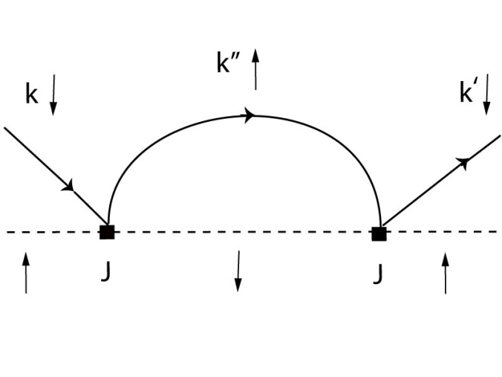

Slide 9
Kondo Problem
the term diverges at low temperature as T → 0, and higher order scattering gives terms proportional to with m >1, which diverge more rapidly.
the Kondo temperature:
Kenneth Wilson (1975): „numerical renormalization“

Slide 10
Kondo resonance in quantum dots
Quantum dots are isolated islands of electrons created in nanostructures that behave as artificial magnetic atoms.
The advantage of quantum dots is the ease with which the parameters of these artificial atoms can be controlled (by adjusting the voltages on the gates): the energy of the single electron level, ist width, and the Coulomb repulsion energy.

Slide 11
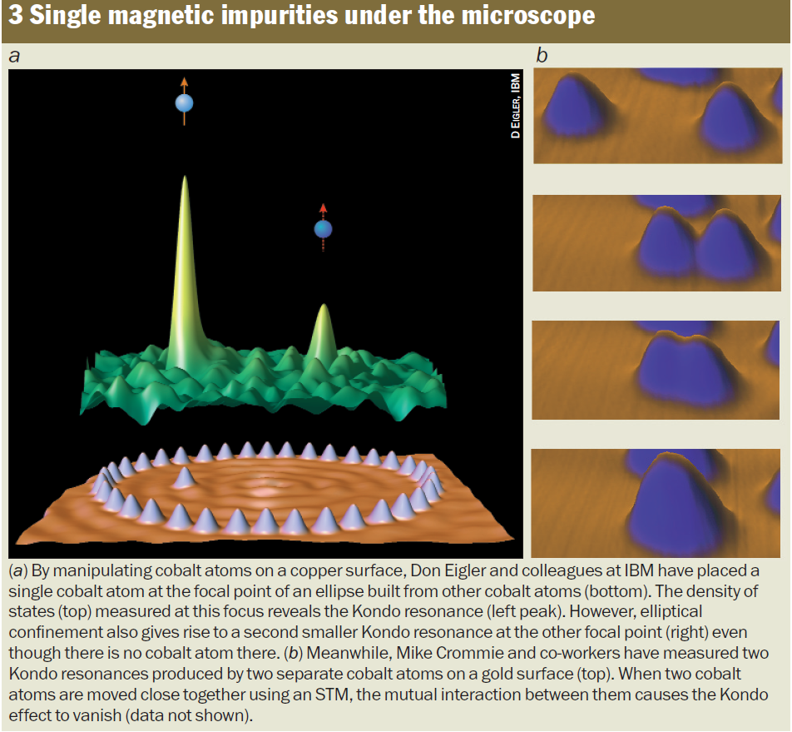
Kondo‘s Future
Scanning tunnel microscopy and quantum-dot devices: new tools for studying the Kondo effect
One ongoing debate: Kondo cloud consists of electrons that have previously interacted with the same magnetic impurity → the electrons are mutally correlated
Investigations into the interactions between magnetic impurities

Slide 12
Thank you for listening
    „The Revival of the Kondo Effect“ –Leo Kouwenhoven and Leonid Glazman
    „Resistance Minimum in Dilute Magnetic Alloys“-Jun Kondo (Original Paper 1964)
    „Sticking to My Bush“-Jun Kondo (Experimental Paper 2004)
    http://www.scholarpedia.org/article/Kondo_effect
    „Introduction to Many Body Physics“ – Piers Coleman (2011)

